Slide 1
Phase 1 Outline
Amazon
Zachary Warunek and Nash Reigle

Slide 2

Amazon Database Outline
To create a database that houses the information of multiple user’s personal data, history, and interests.
They have an ability to connect users with sellers to provide products across the globe
Notes:
Amazon is a multinational technology company based in Seattle Washington and has reached the “big five” as a tachnology company along side google Apple Microsoft and Facebook.
Amazon was largely an online seller until it accuquired Whole Foods market in 2017 and began selling as a physical retailer

Slide 3
Requirements
Tables would be required for:
Customer personal information
Products
Payment Methods
Viewing history
Orders
Shopping Cart
Recommendations
Product List for User

Slide 4
Requirements
The data for the people would require a table of:
Customers(ID:string/int, Fname:string, Lname:string, address:string, password:string, PrimeMem:int)
ID
First Name
Last Name
Address
Password
Prime Membership
Notes:
The customers would need multiple forms of information on file. The ID could either be a string or a number, the first name, last name, address, and password would be strings, and the Prime membership could be stored as a date, seeing as a membership is a subscription and not a one time purchase.

Slide 5
Requirements
Table for Product:
Product(ID:string/int, Name:string, Descr:string, Price:real, Deal:real, Prime:binary)
ID
Name
Description
Price
Deal
Prime

Slide 6
Requirements
Table for payment methods
PM(PMType:String, PMid:string, PMtype:string, PMcardNumber: PMexp:int, PMcvv:int, PMfav:binary)
Payment Method Type Payment Method ID
Payment Method Service Type
Payment Method Card Number
Payment Method Expiration Date
Payment Method “Card Verification Value”
Payment Method Favorite
Notes:
The payment method would store information such as the credit card number or account id for digital payments, the card expiration and CVV if applicable, and a binary option if the card is the favorite to default to that option

Slide 7
Requirements
Table for view history
VH(VHProID:string/int,ViewDate:int)
View History Product ID
View Date
Notes:
If the customer views a product, it will show up in the viewing history as well as the day it was viewed. The customer will have an option to remove items from the viewing history.

Slide 8
Requirements
Table for purchase history
PH(PHID:string/int,PHDate:int, PHPrice:real, PHPrime:binary, PHDelAdd:string, PHPayment:String, PHStat:string)
Purchase History ID
Purchase History Date
Purchase History Price
Purchase History Prime
Purchase History Delivery Address
Purchase History Status
Notes:
The Purchase history table will contain information regarding an order such as the products in the order, the date the order was completed, the total, if the order qualifies for prime, and the status of the order(In-process, Shipped, Delivered, Cancelled, or returned).

Slide 9
Requirements
Table for the Shopping cart
SC(SCProID:string/int, SCQuant:int, SCPrice:real, SCDeal:real, SCPrime:binary)
Shopping Cart Product ID
Shopping Cart Quantity
Shopping Cart Price
Shopping Cart Current Deals
Shopping Cart Prime
Notes:
The shopping cart will hold information about individual products that a customer has selected, the quanity, the price, any applicable deals, and their eligibility for prime.

Slide 10
Requirements
Table for Recommendations
Rec(RecType:string, RecTag:string/int, NumView:int, RecRel:int)
Recommendation Type
Recommendation Tags
Number of Times Viewed Recommendation Relevance
Notes:
The recommendations will be a table that is used for generating recommended products. The recommendation type will determine if the recommendation tag is a tag or a seller, and the number of times viewed counter will increase if a person visits or buys a product. In order to keep things relevant to the consumer, the table has a “most recently accessed” date, so a tag with less hits but was viewed recently will rank higher for recommendations. The consumer will be able to say “I am not interested in ___” to fine tune their recommendations or sellers.

Slide 11
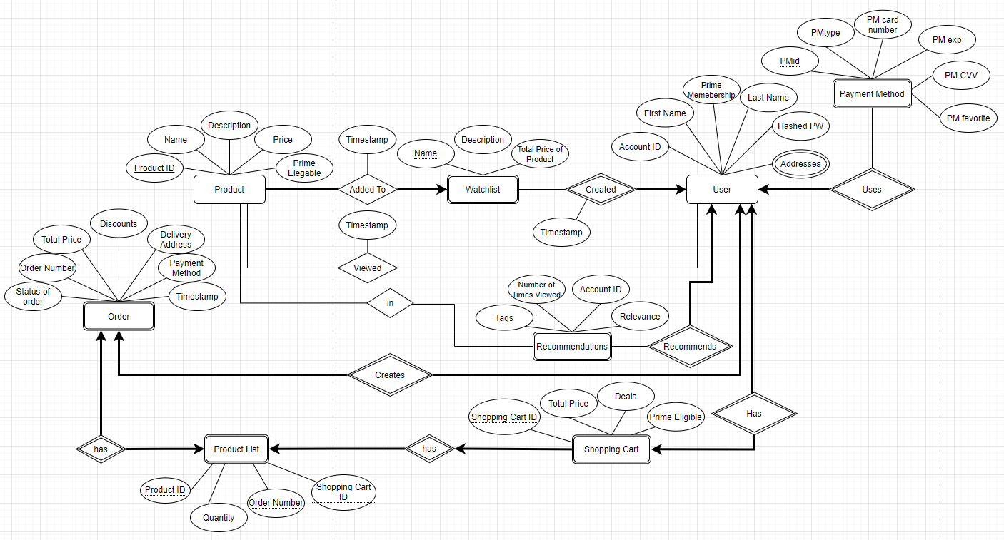
Diagram

